Slide 2
OBJECTIVES
Explain GitHub
Differentiate between Git and GitHub
Describe how to create a GitHub repository
Describe Branching, Committing, and Pulling in GitHub

Slide 3
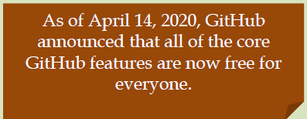
INTRODUCTION TO GITHUB 1-2
Setting Up and Maintaining code on GitHub
Platform for users to work together and create collaborative code
Store
Manage
Control and Track the repositories

Slide 4
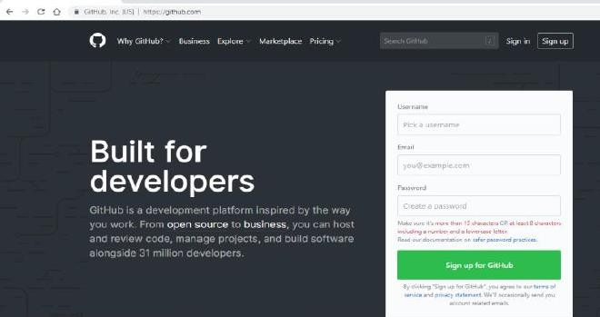
INTRODUCTION TO GITHUB 2-2
Public account are free of cost whereas private is to be paid
View the repositories created
by the user on GitHub

Slide 5
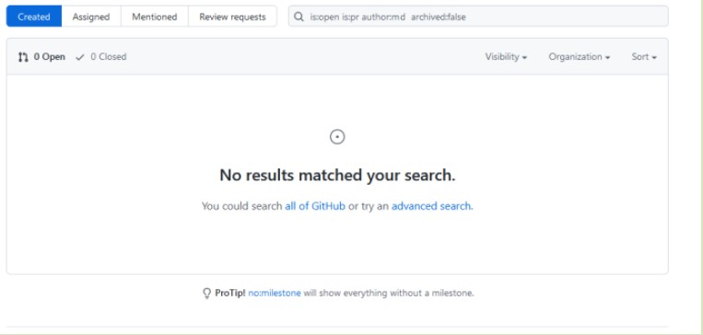
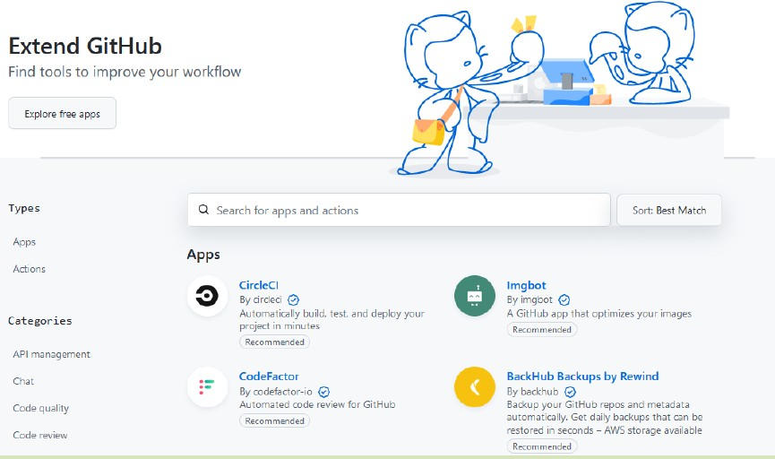
GITHUB WEB INTERFACE 1-2
Collaboration of users
Extend and Explore GitHub
Marketplace menu displays tools/apps on GitHub
Enables users to check topics, trending repositories, and more

Slide 6
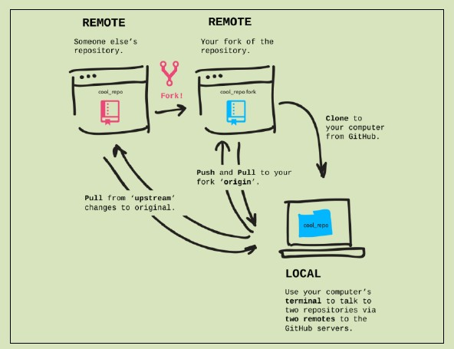
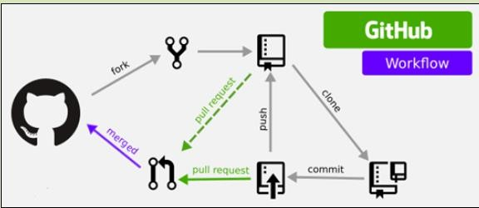
GITHUB WEB INTERFACE 2-2
Cloning Mechanism
Process of Pushing
Image Courtesy: https://levelup.gitconnected.com/how-to-sync-forked- repositories-usinggit-
or-github-2933e497fa16
Image Courtesy: http://jlord.us/git- it/challenges/forks_and_clones.html

Slide 7
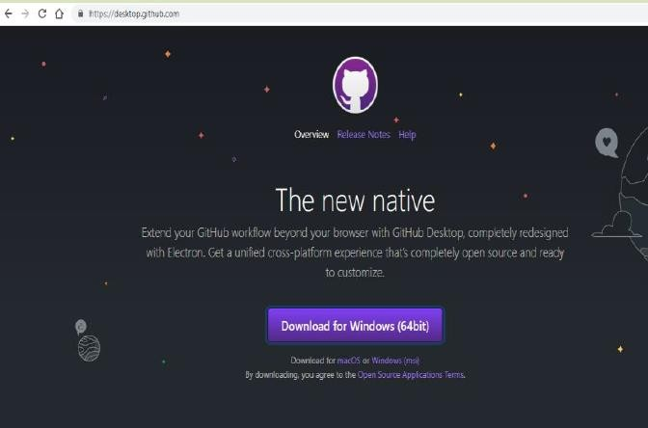
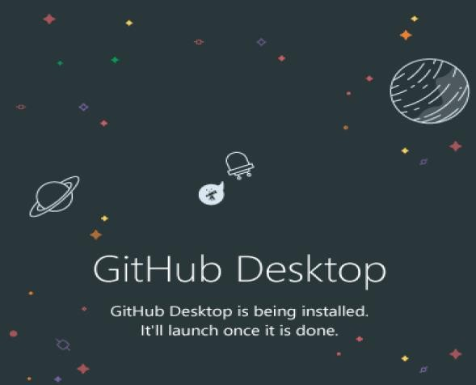
INSTALLING GITHUB DESKTOP
Visit the GitHub Desktop Web page at https://desktop.github.com and download the .exe file.

Slide 8
GITHUB BASICS
GitHub
Creating Repository
Branching in GitHub
View and Delete Branches
Committing in GitHub

Slide 9
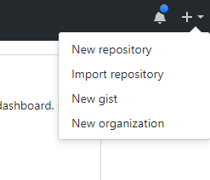
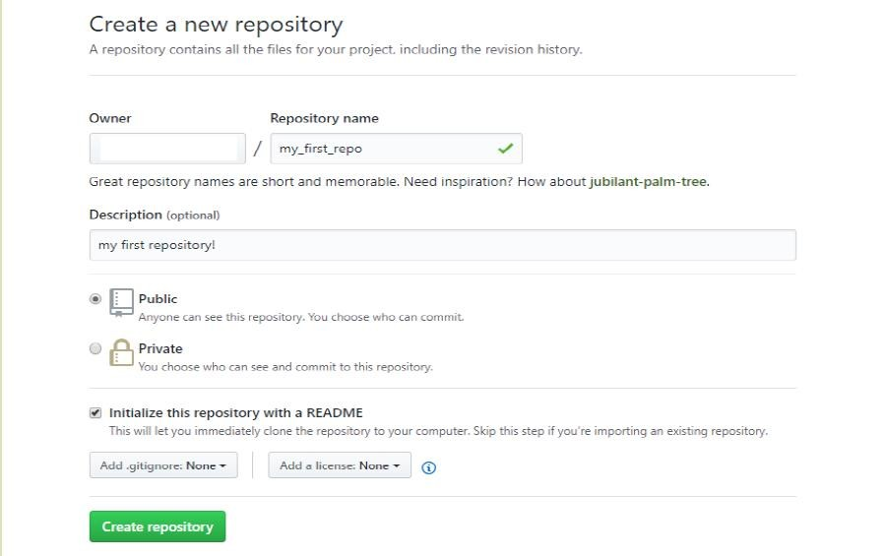
CREATING A REPOSITORY IN GITHUB
Navigate the GitHub page
Initialize the repository

Slide 10
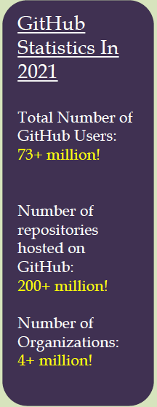
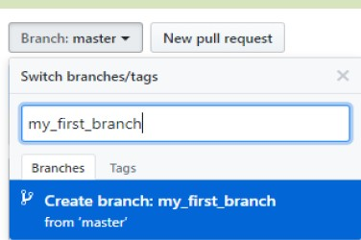
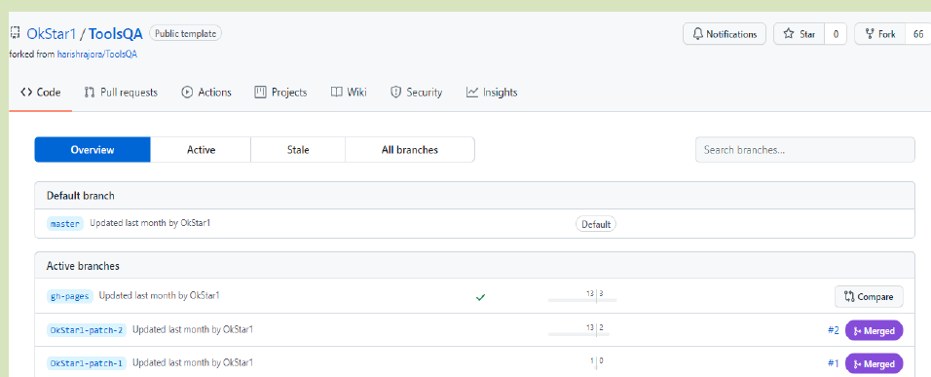
BRANCHING IN GITHUB
View the Default and Active branches

Slide 11



VIEWING AND DELETING BRANCHES 1-2
Your branches: Displays the recent ones first.
Active Branches: Displays the last three
months branches
Stale Branches: Inactive branches
All Branches: Default branches

Slide 12





VIEWING AND DELETING BRANCHES 2-2
User should navigate on main page
Steps to View repository
Click <number> branches, where number indicates the current branches
Steps to Delete repository
Scroll to deleted branch and click Delete symbol

Slide 13
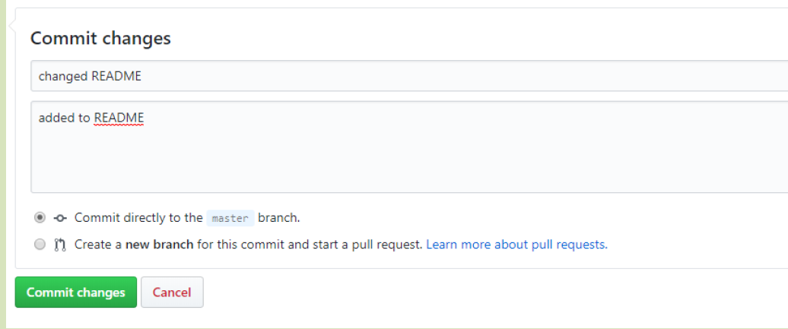
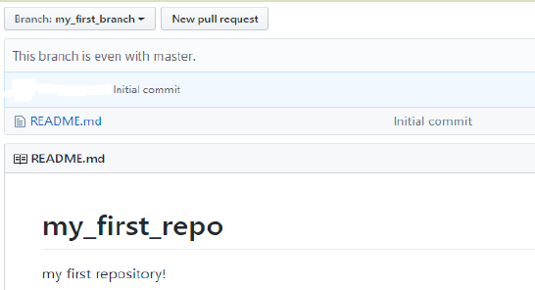
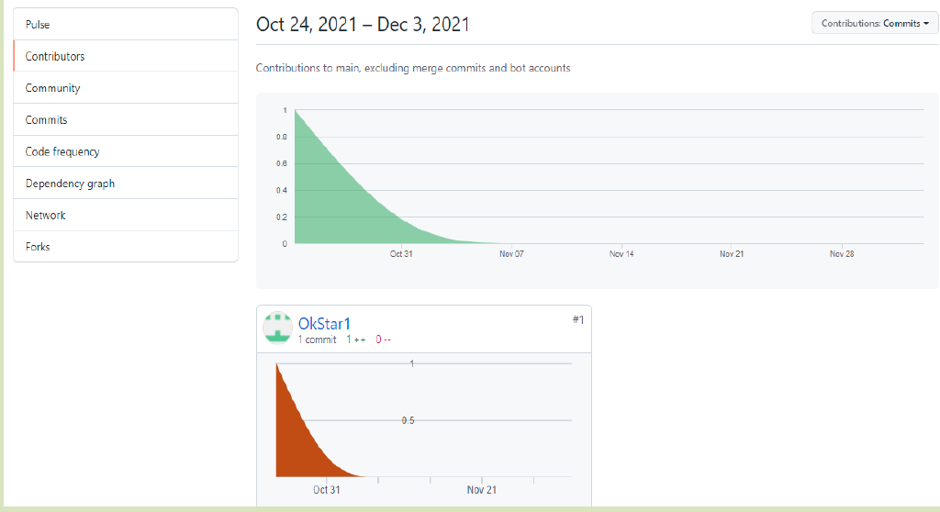
COMMITTING IN GITHUB

Slide 14
SUMMARY
GitHub is a platform for developers to work together and create collaborative code
GitHub repositories enables users to implement version control for projects
Branches allows users to create features, fix issues, or explore within the repository
Commit enables to save changes to the repository

